Slide 1
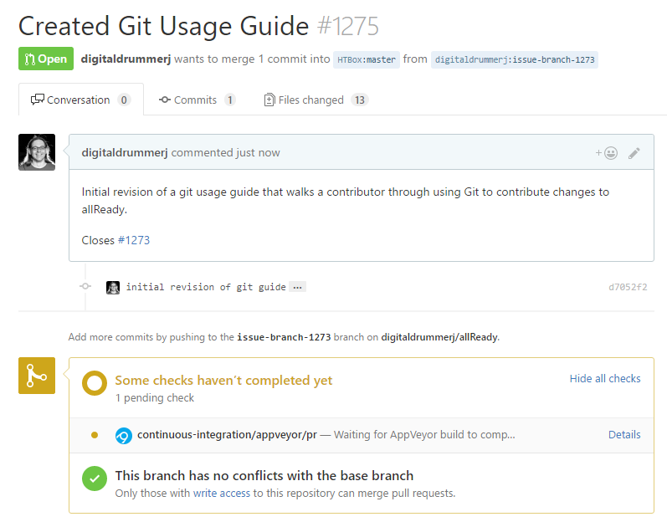

Documentation
Git Usage for already
Prerequisite Install Guide
Event instructions

Slide 2
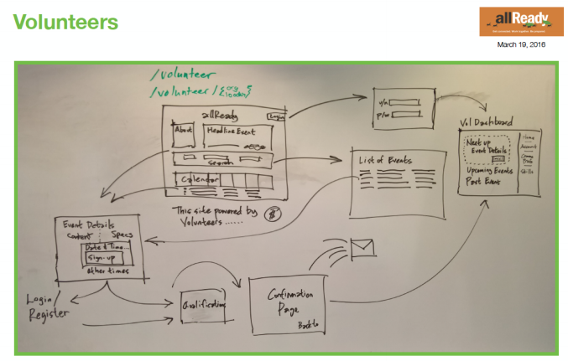
Design
Mostly driven by volunteers, managed by an Azure database infrastructure

Slide 3
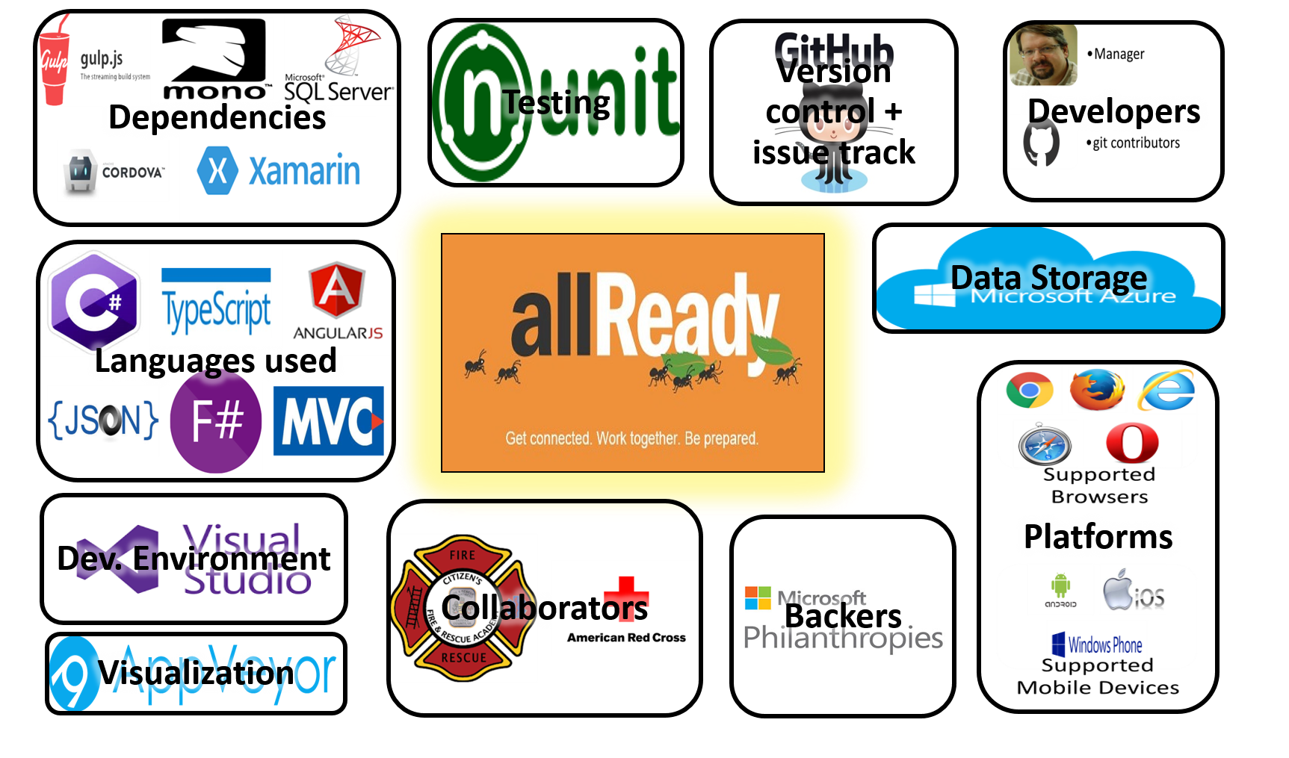
Context Diagram

Slide 4
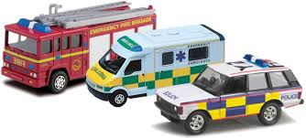

Stakeholders
Assessors, who check for compliance. Working in tandem with the allReady staff, relying on their results and handing requests and feedback.
Red Cross: (Director: @Jim McGowan)
Communicators, who create documents and training. Most of the documents are yet to be written, with the exception of the "getting started" tutorials for volunteers, which were written by allReady's core-developers
Github contributors
Developers, who create the system / Maintainers, who evolve and fix the system
Core developers: Staff skilled in management, knowledgeable in programming; mainly in Web, SQL, .NET, and AngularJS
Web team (Rohit, Elizabeth, Matt, Dan, Daniel, Glen, Connie)
Mobile team: (Jimmy, Dmitry, Parashuram, Louis, Guillaume)
Volunteering coders:
open-source contributors who volunteer to work on the improvement of allReady

Slide 5



Stakeholders
Production Engineers, who are responsible for the deployment environment.
Core developers: Staff skilled in management, supervising and directing the development of allReady; Seth Juarez (technical) Dmitry Lyalin (Senior Product Manager) Brady Gaster (Program Manager) Kirupa Chinnathambi (Senior Program Manager) Pranav Rastogi (Program Manager) Tarvis Lowdermilk (UX designer) Zlatko Knezevic (Program Manager) Jeff Fritz (Senior Program Manager)
Suppliers, who provide parts of the system. External companies which provide tools/ professional advisory/ software infrastructure Microsoft (contributing working platform, free server use and storage, and professional advisory and guidance) and various contributors
Support Staff, who help people to use the system. Technical staff, who help participants with hardware installation Volunteers with various helpful skills during the emergency of unexpected disasters Various others. For example, people who help raise readiness in a town by assisting in the installation of smoke detectors wherever the residents can't do so on their own

Slide 6

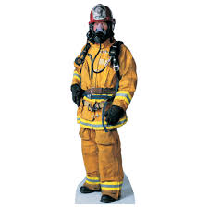
Stakeholders
System Administrators, who keep it running. Main manager (Richard Campbell) Advisors from Microsoft (backlog /pool / task-sharing management , operation monitoring and various logistics)
Testers, who verify that it works. Every programmer (core developer or contributor) is required to make his own test and make sure his addition / revision works well.
Users, who have to use the system directly. The organizations which physically deal with the disaster by aiding the locals, and the aided victims of the disasterous event. Examples for emergency services: Red Cross, Police, Fire-fighters... Examples for victims: people from towns caught in hurricane/earthquake/forest fires

Slide 7
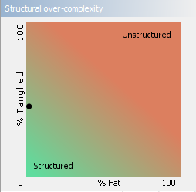
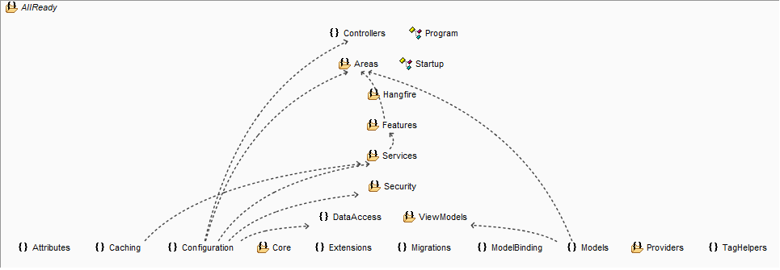
Features analysis
The code seems to be a bit tangled, though well-categorized.
allReady's app is sparse at its structure (reasonable for a project largely developed by volunteers), and is somewhat tangles.

Slide 8
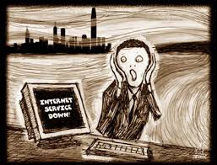
Challenges for allReady
In all disaster scenarios, the system has to be at least as reliable as "pen and paper". Some disasters may render crucial infrastructures inoperable, thus suitable solutions have to be prepared ahead of time;
for example, in case internet connecivity is weakened or lost at the disaster site, allReady's data transfer can be disrupted and resumed. If necessary, vehicles with wi-fi are brought to the site to allow a complete transfer.

Slide 9
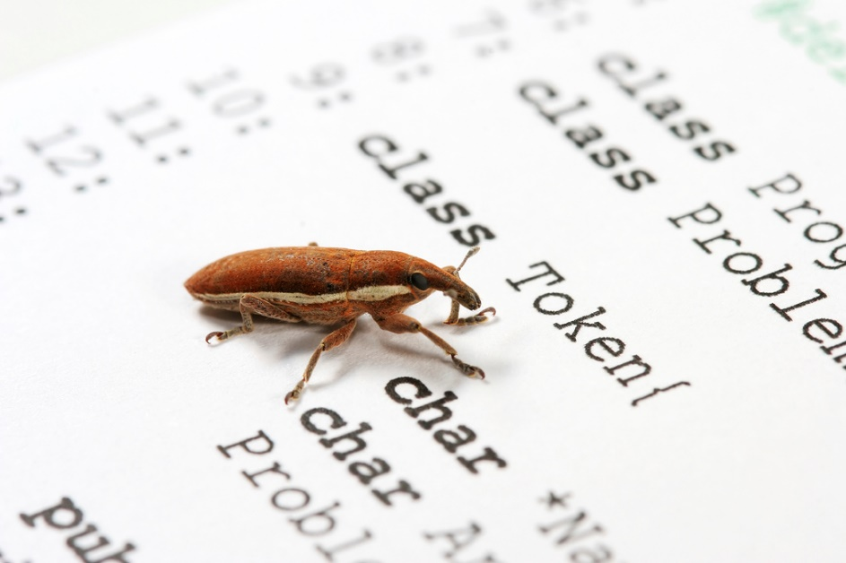
Challenges for allReady
Known bugs / issues:
Missing lots of docmunetation
Individual volunteers are unable to contact the admins unless they are part of a registered organization
Inconsistant naming in code
In-app map does not support Internet Explorer
Missing part in tutorial about sql handling
Volunteers are not messaged / contacted yet in an ordered fasion

